Slide 1
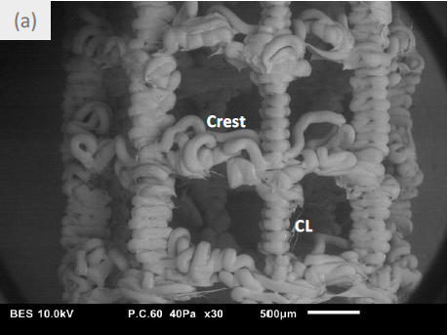
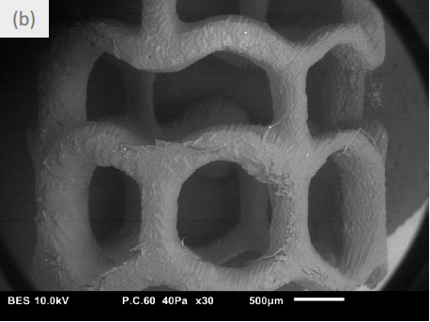
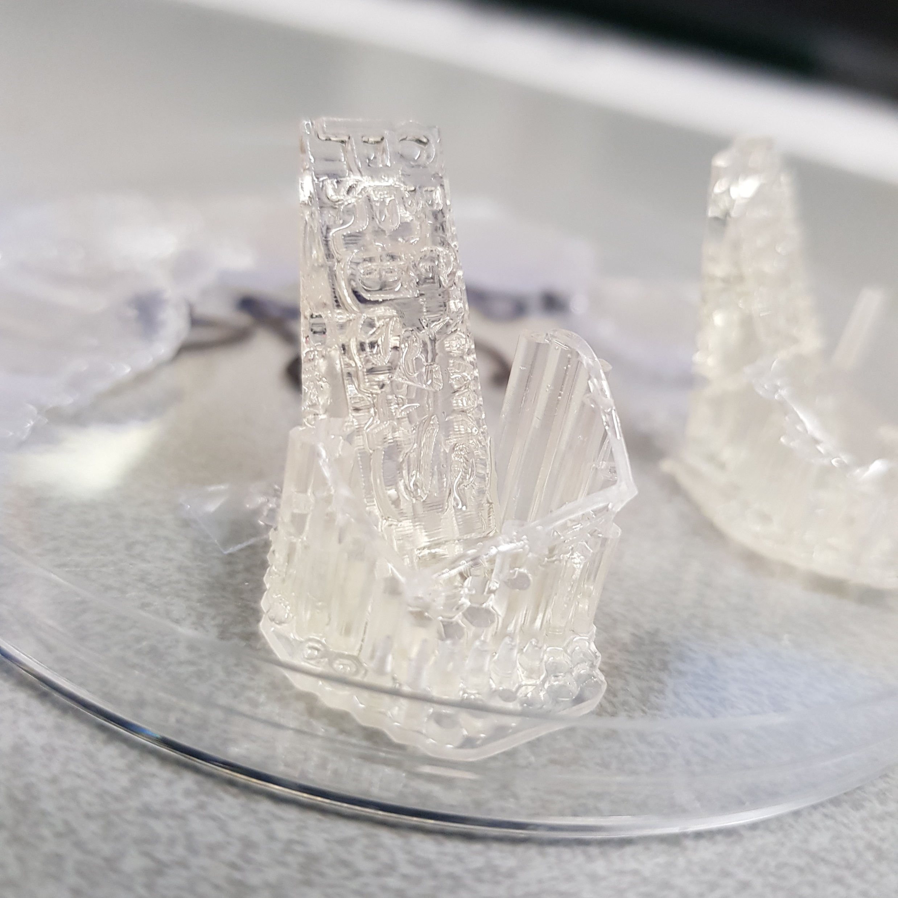
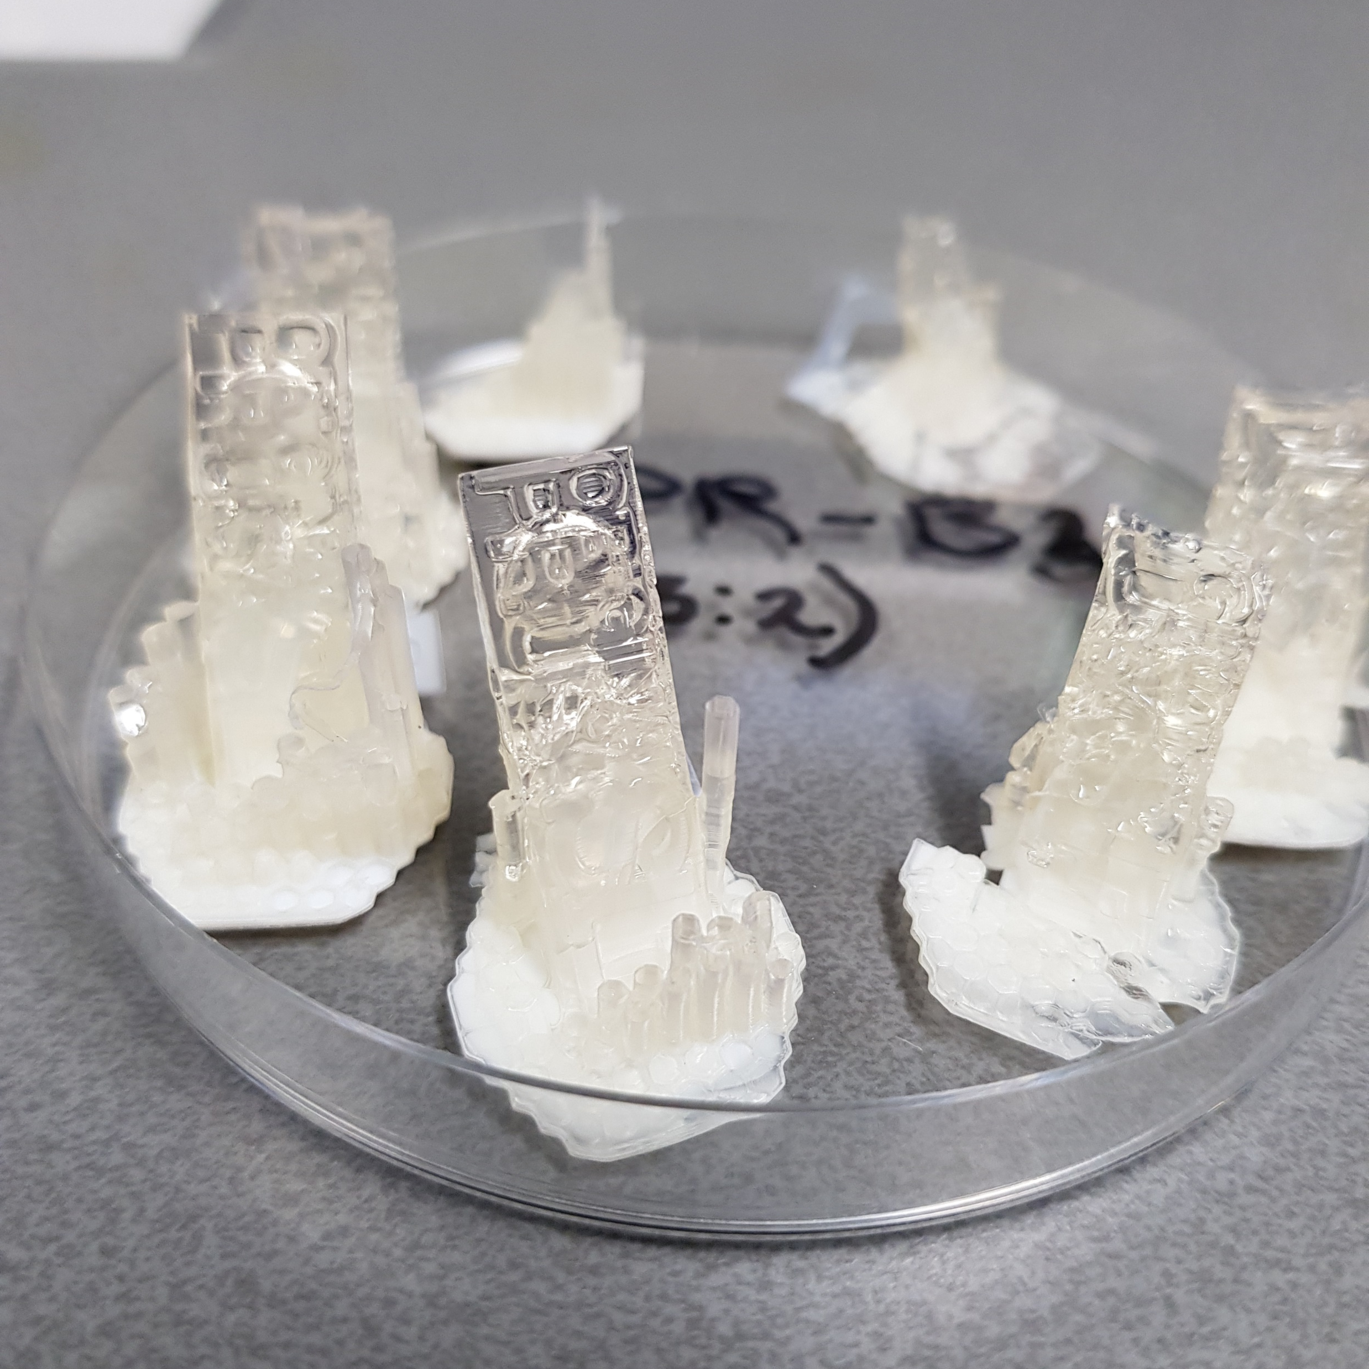
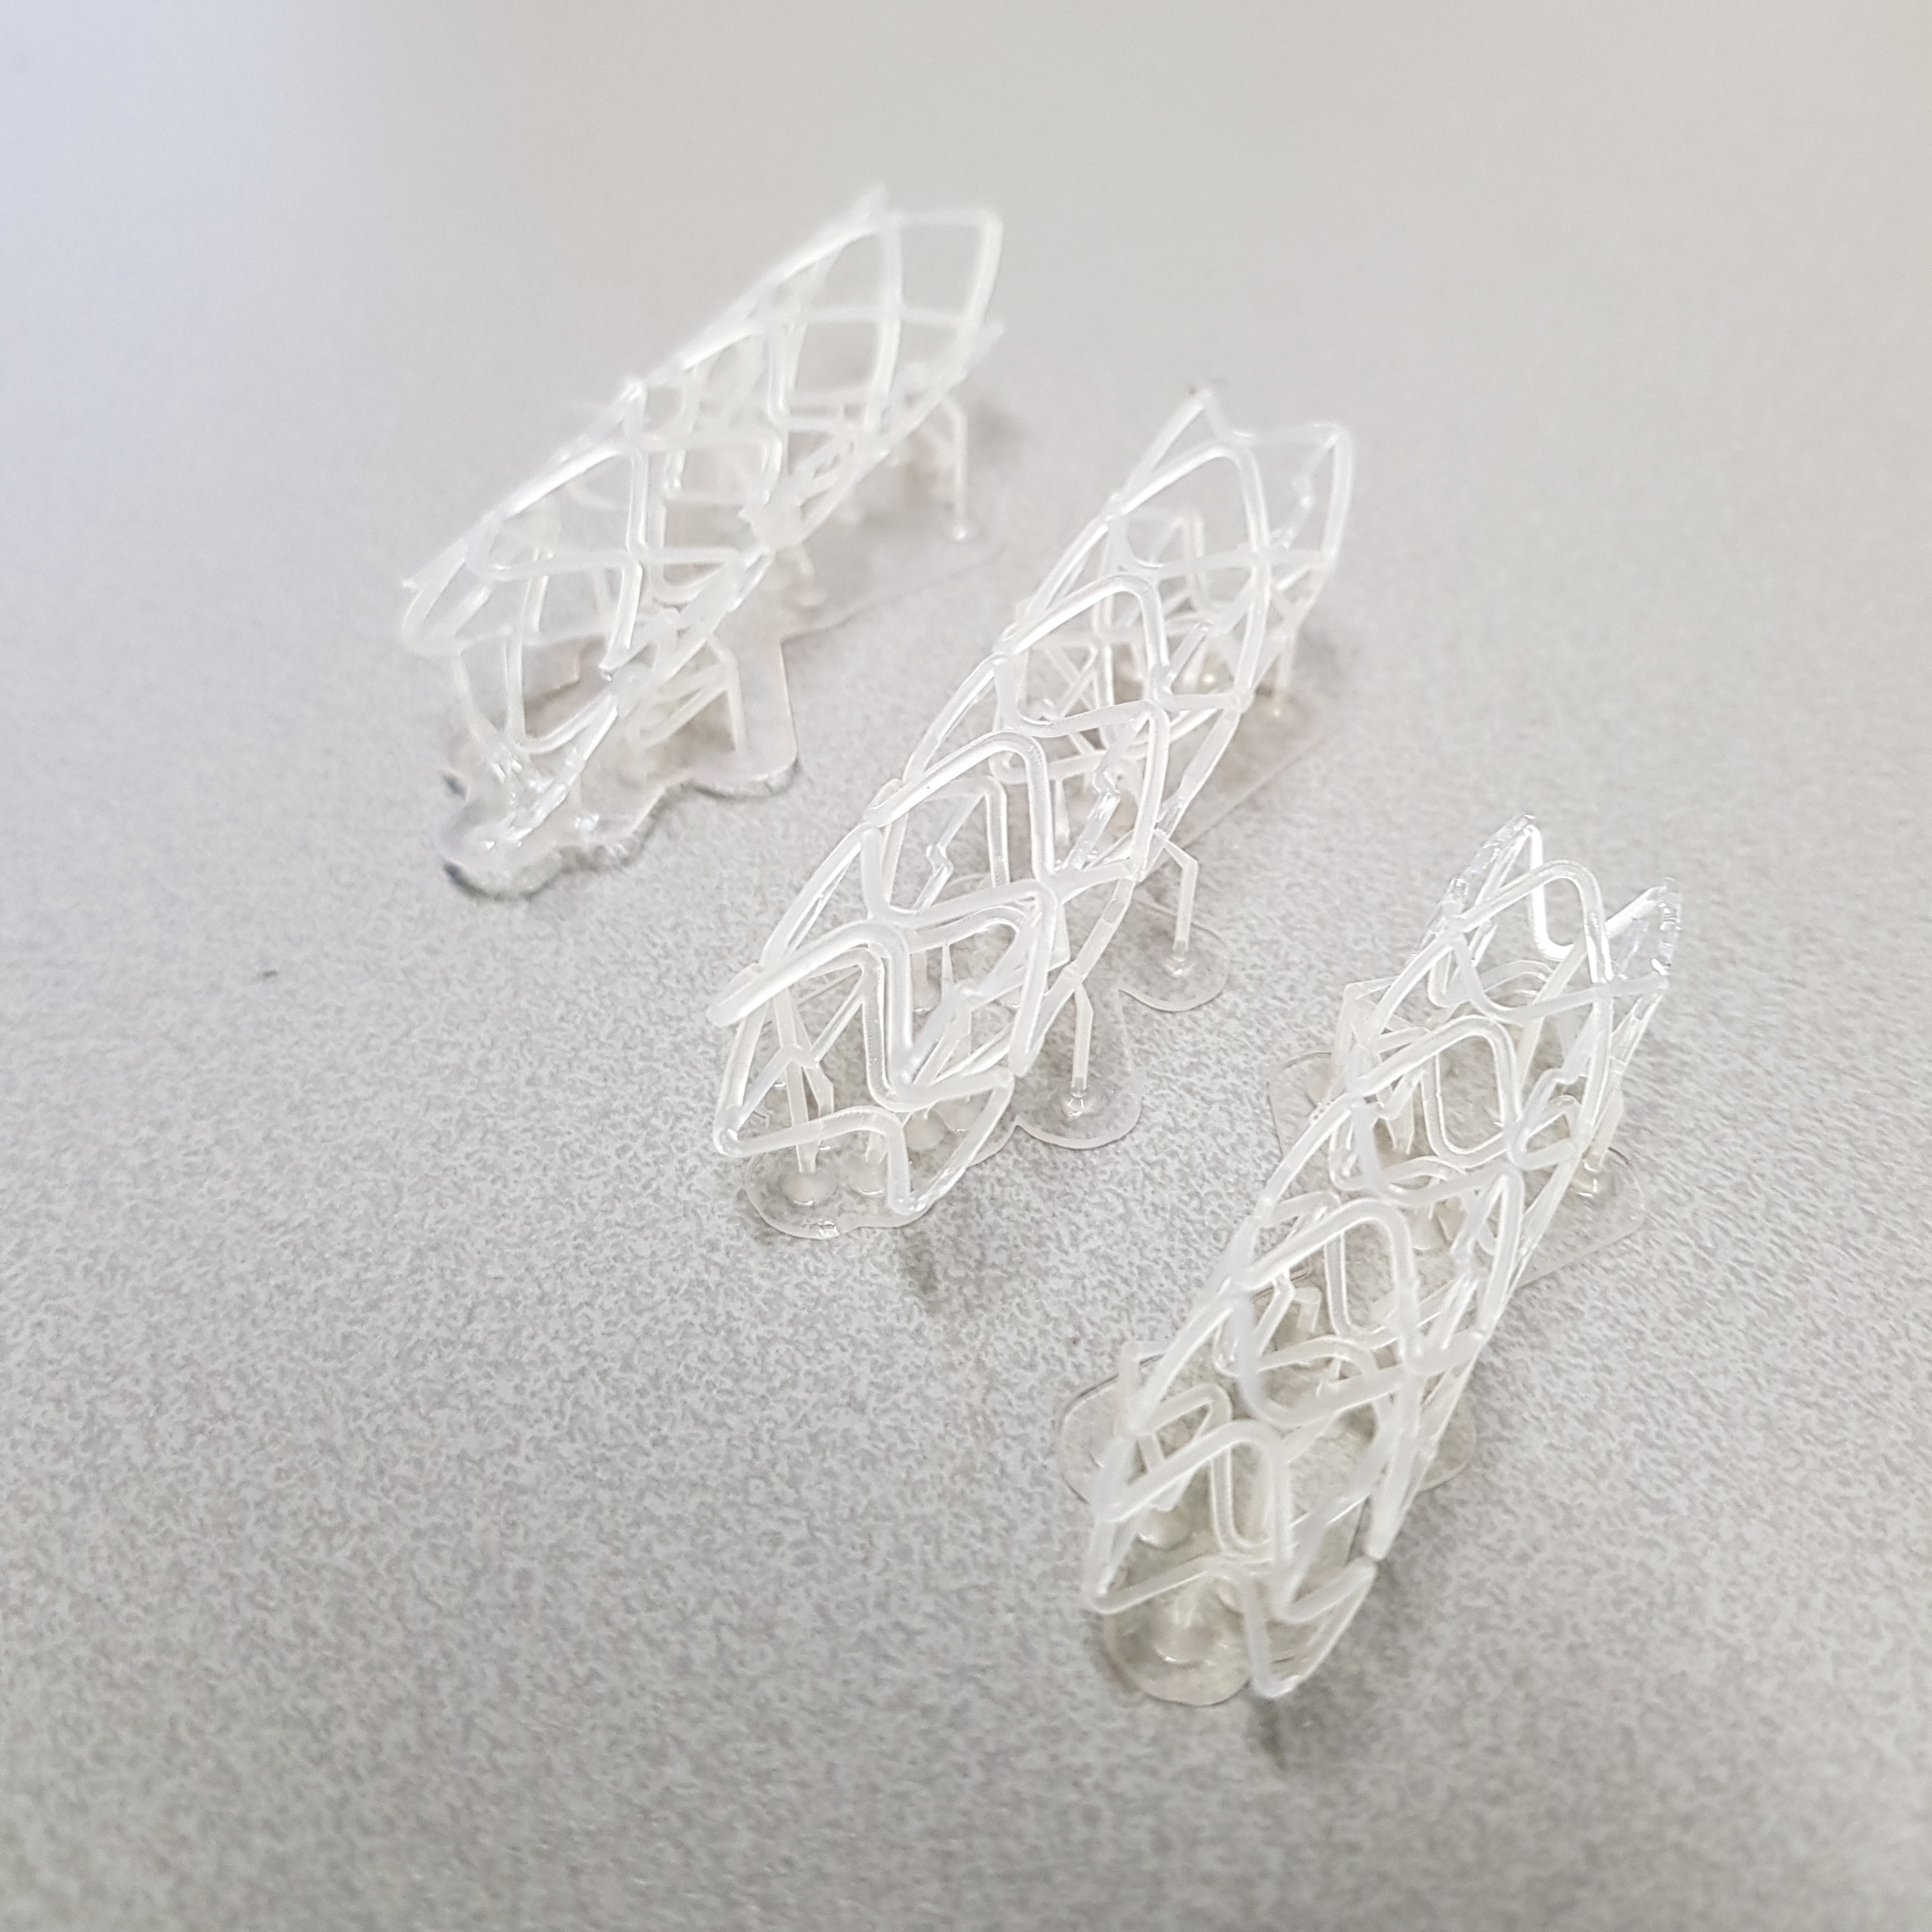
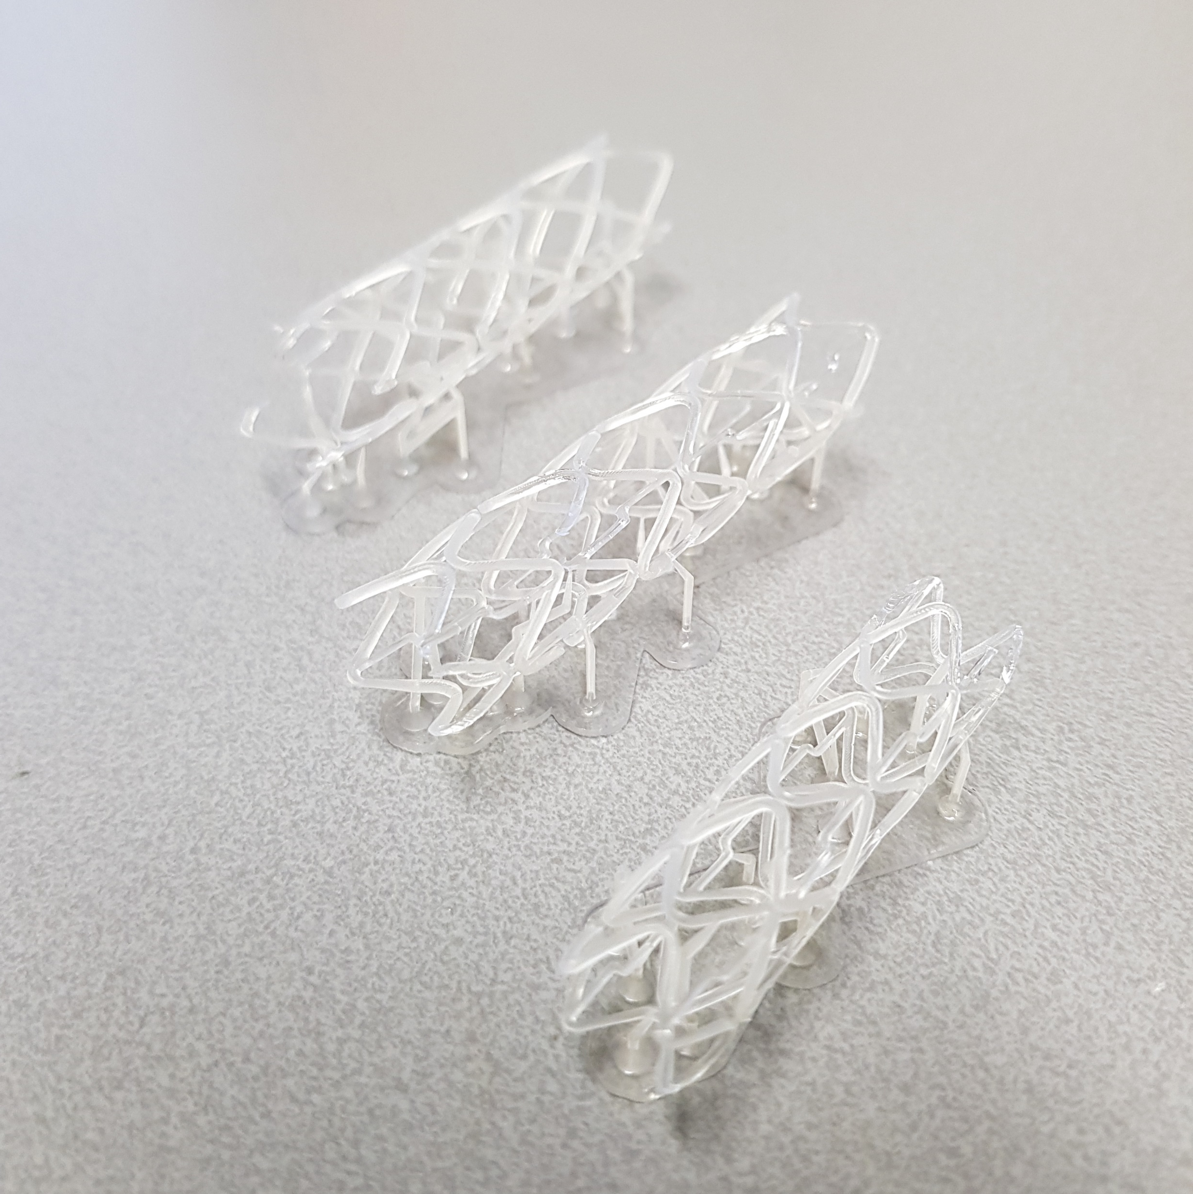
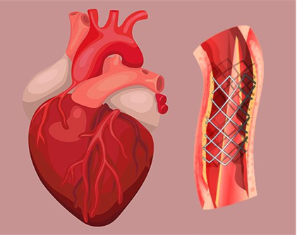
BIOCOMPATIBLE PHOTOCURABLE RESINS FOR (BIO)MEDICAL APPLICATIONS
TOWARDS A BIOCOMPATIBLE CARDIOVASCULAR STENT
H. Doesª, M. Leemhuis^{a,}*, E. de Vlugtª
ªThe Hague University of Applied Sciences; Faculty of Technology, Innovation & Society; Johanna Westerdijkplein 75, 2521 EN, The Hague.
*corresponding author: Mark Leemhuis, m.leemhuis@hhs.nl
BACKGROUND
METHODS
Cardiovascular stents are made of metal, but this is not always needed or desired. 3D printing is an attractive alternative.
For (bio)medical applications 3D printed products must meet stringent requirements.
FDM is the most widely used printing method today but cannot reach high resolution. Stereolithography (SLA) is an interesting alternative to reach higher resolution.¹
Here we investigate the possibility of using (meth)acrylates and vinyl esters in an effort to expand the currently available supply of biocompatible resins.
SLA uses photocurable resins to make prints.
Masked SLA (mSLA) was used instead of conventional SLA.
mSLA cures an entire layer at a time and therefore uses less time than conventional SLA.
Several formulations were prepared and tested for printability.²
Schematic representaion of conventional SLA.
Schematic representation of mSLA.
Electron microscopy pictures of an FDM printed cardiac stent (figure a, left) and an SLA printed cardiac stent (figure b, right), taken from reference 1 with permission.
Resin | Isobornyl acrylate | 1,6-Hexanediol dimethacrylate | Pentaerythritol tetraacrylate | Dipentaerythritol penta-/hexa-acrylate | Bisphenol A glycerolate (1 glycerol/phenol) diacrylate | Absolute Ethanol (Ratio)
BPR A | 20 | 40 |  | 40
BPR B | 20 |  | 40 | 40
BPR B2 | 20 |  | 40 | 40 |  | 3:1
BPR B3 | 20 |  | 40 | 40 |  | 3:2
BPR C | 20 |  | 40 |  | 40
Composition of prepared resins.
RESULTS
CONCLUSIONS & OUTLOOK
The biocompatible resins were submitted to a resin calibration test to find out its best curing time per layer.
High exposure times (ca 60s/layer) were found to be needed when using our own resins instead of commercial resins.
Several resins were made and printed successfully.
All formulations demonstrate functionality and are polymerizable by UV-light based mSLA technology.
Viscosity is an important parameter in printability, dilutions are sometimes needed.
More formulations will be investigated to increase biocompatibility and possibly also biodegradability.
With the present results we are closer to manufacturing 3d printed cardiovascular stents.
8 separate prints are built up on one plate, each with an individual exposure time to quickly assess the correct settings.
Printed cardiovascular stents from several different resin compositions.
A traditional (metal) cardiovascular stent in place.
REFERENCES
Thesis Jonathan Cortes, TuDelft, 2017
Voet, V. S. D., 2018. ACS Omega, 3(2), 1403–1408

