Slide 1
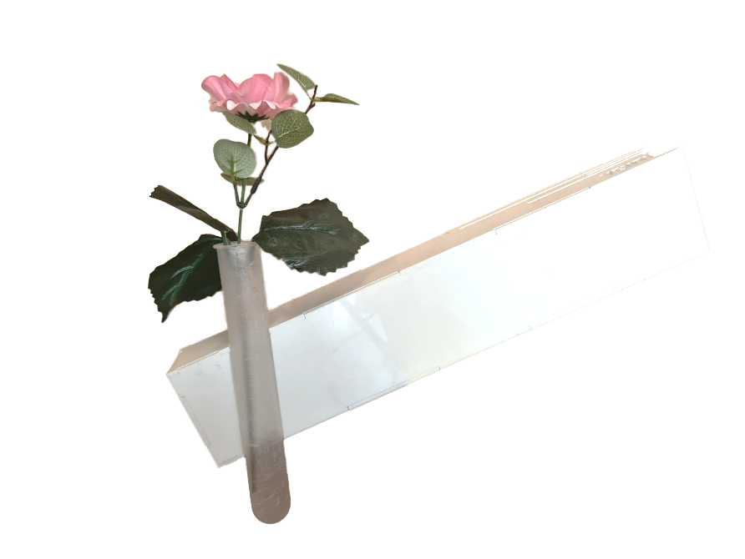
Old design:
Venti is a product that measures the temperature and air quality in your home. Based on this information, a linked app will tell you when it is best to open your window or door to optimize the temperature and air quality in your home.
A prototype of this product has already been made. It is our task to improve upon this product.
We are also developing a new app that can communicate with the device. In addition to the app, you will also be able to see on the product itself what action you need to take to keep your in-house temperature and air quality optimal.
Redesign:
Different look
Sustainable /Circulair
HAN indication
Cheaper (± €50,-)
At least 50% smaller than first prototype
Hardware optimalisation
Venti measures:
Humidity
Temperature
CO2 level
Particulate matter
HAN Powerlab
Hybrid Learning Environment

