Slide 1
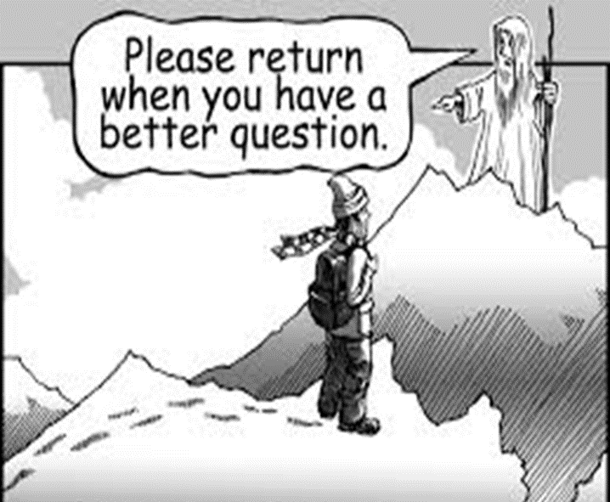
Developing Questioning Literacy with the Question Compass

Slide 2
Harry Stokhof
Introduction
Ilse Wintermans
Jeroen van den Linden

Slide 3
What to expect in this workshop?
Context: question-driven learning
Brief report on findings of design-based research
Emerging challenge: question literacy
Hands-on experience
Potential solution: hypothetical question learning trajectories

Slide 4
Context: question-driven learning ( in primary education)
(Social) Science curriculum
Inquiry-based learning
Student questions

Slide 5
Why student questioning?
Aligns personal interest to learning
Supports own responsibility for learning
Supports research skills
Supports critical thinking
Supports communication skills
Supports meta cognitive skills

Slide 6
Teacher’s challenges when guiding student questioning
Questioning Culture
Alignment to Curriculum
Questioning
Literacy

Slide 7
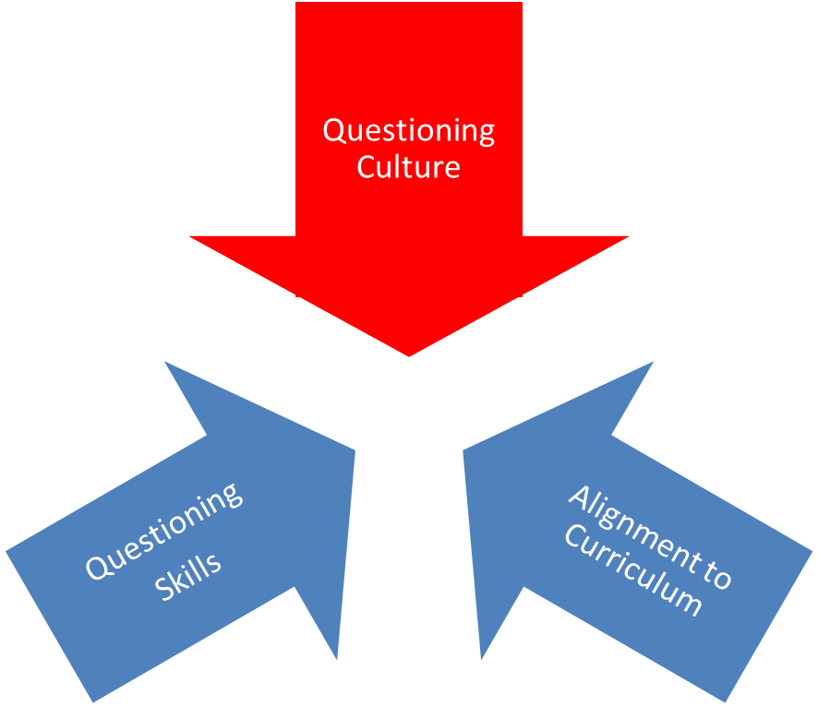
Support for questioning culture: guiding principles
Provide space
Offer focus
Share responsibility
Visualize process

Slide 8
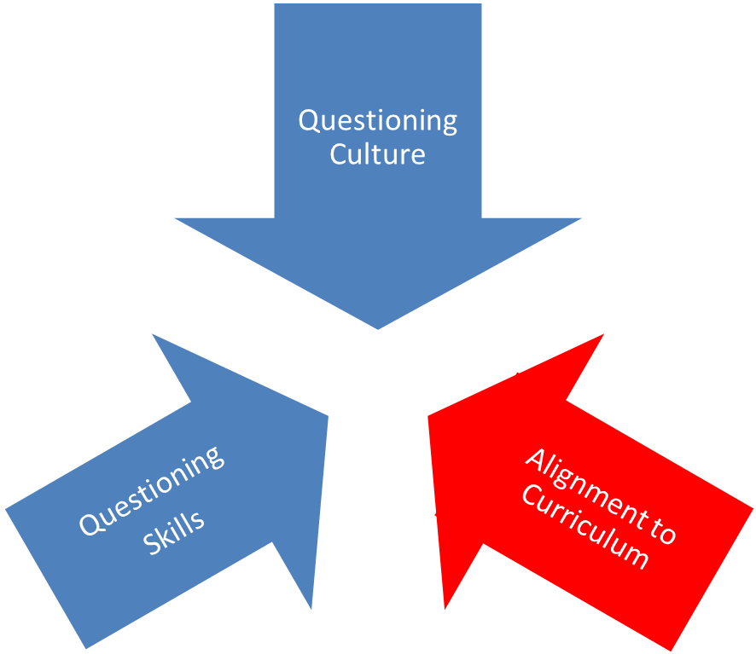
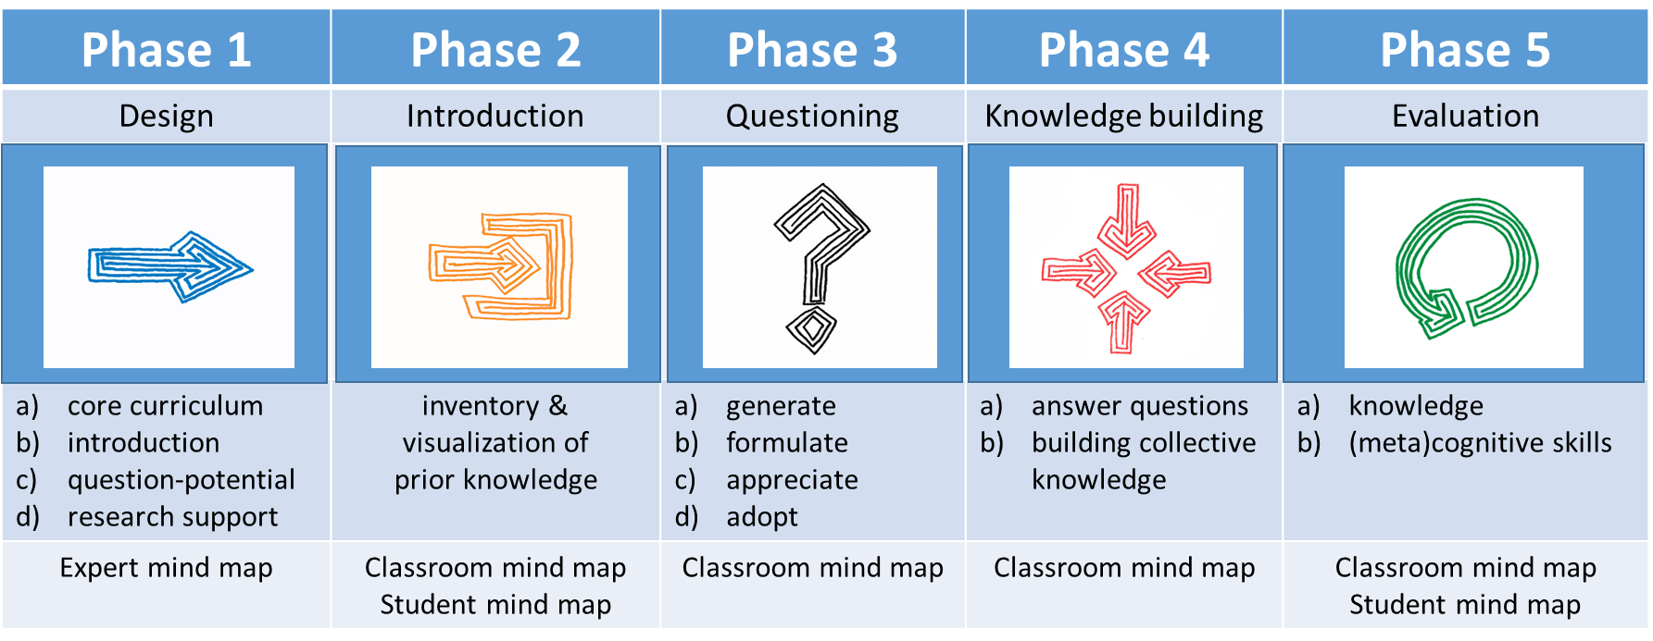
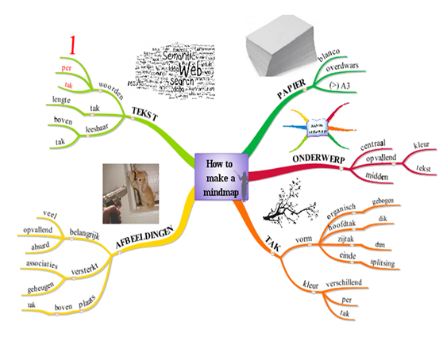
Support for alignment to curriculum: scenario
= visualizes process in all fases

Slide 9
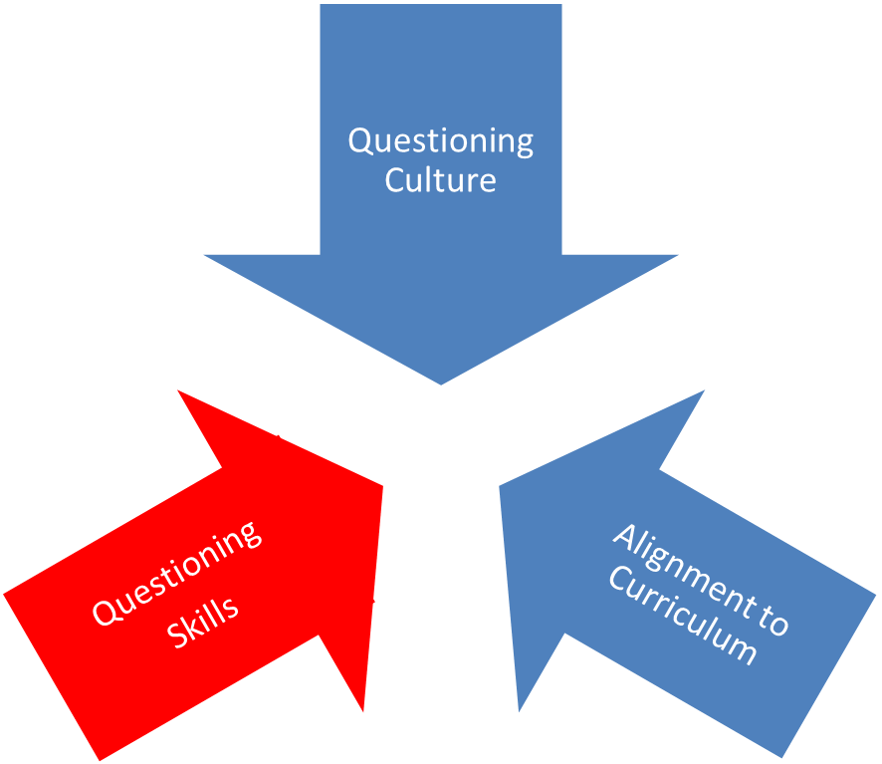
Emerging 3th challenge: questioning literacy
Students ask “vague questions”
“Uh…. something about a dinosaur egg?”
“Why are trees green?”

Slide 10
students’ questioning literacy
Awareness of
personal curiosity
potential questions
quality of questions for learning
Ability to
formulate questions
choose most relevant question
reformulate if necessary to enhance quality

Slide 11
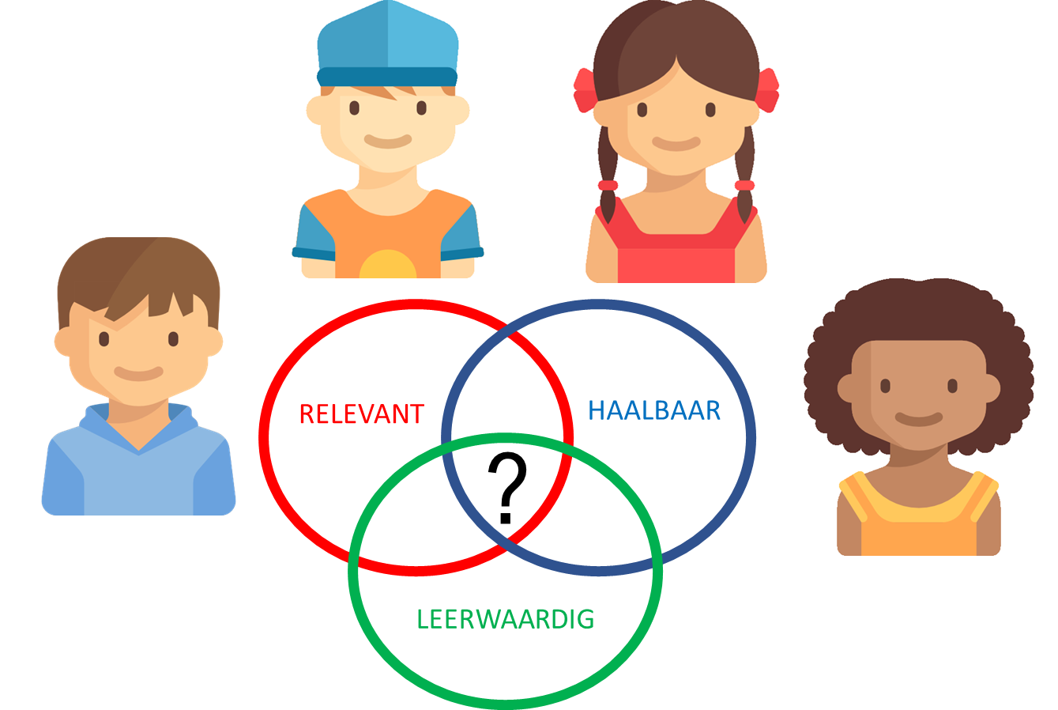
What kind of question quality?
RELEVANT
FEASIBLE
LEARNING
POTENTIAL
Meaningful?

Slide 12
What kind of question quality?
MEANINGFUL
RELEVANT
FEASIBLE
LEARNING
POTENTIAL

Slide 13
Teacher’s challenges
Bring focus in vague questions?
Make them researchable?
Enhance learning outcomes?
Maintain student involvement in this process?

Slide 14
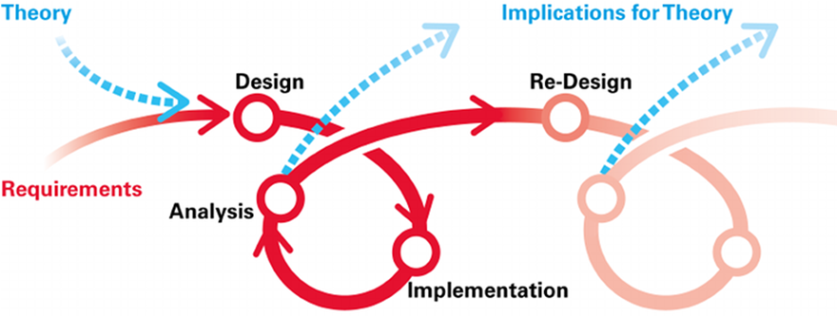
Designing a solution?
Design-based research
2 year = 4 cycli
4 design teams
30 participating teachers
Notes:
afbeelding verkregen op 8 mei 2016 van
https://www.nl.capgemini.com/sites/default/files/onlineblog/files/2012/02/Problem-solving.jpg

Slide 15
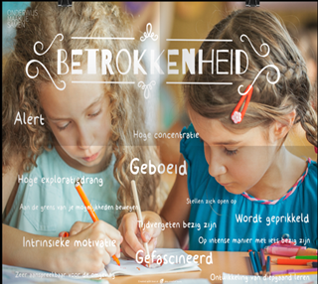
Design objective
How can teachers support students to formulate their curiosity (meaningful) in relevant, feasible questions that have sufficient learning potential for themselves and the classroom community?

Slide 16
Theory: motivation or training?
Motivation takes student's interest as a source of power, but .... quality of questions varies greatly & little support for questioning literacy
Training teaches students type questions, but
no automatic connection with curiosity
Is this the right question at the right time?
Does not guarantee transfer
Notes:
Training leert leerlingen type vragen, maar
Geen koppeling met nieuwsgierigheid
Is dit de juiste vraag op juiste moment?
Garandeert geen transfer
Motivatie neemt interesse leerling als krachtbron, maar
Kwaliteit van vragen is sterk wisselend
Biedt weinig ondersteuning voor vraagvaardigheid

Slide 17
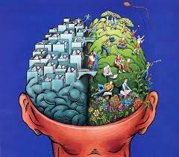
Seeking the best of both worlds?
Notes:
Training leert leerlingen type vragen, maar
Geen koppeling met nieuwsgierigheid
Is dit de juiste vraag op juiste moment?
Garandeert geen transfer
Motivatie neemt interesse leerling als uitgangspunt, maar
Kwaliteit van vragen is sterk wisselend
Biedt weinig ondersteuning voor vraagvaardigheid

Slide 18
Required conceptual tool?
Thinking model that allows:
1) to decontextualize the problem
2) to develop solutions for various contexts
(Bereiter, 2005)

Slide 19
hypothetical question-related learning trajectories
Learn to anticipate on:
Variation in types of questions
Variation in research activities
Variation in learning outcomes

Slide 20
Underlying principles
Starting from the involvement and interest of students
What are you curious about?
Encouraging and supporting students' questioning skills
Every question has potential for learning
Students need images of how they can direct their curiosity
Exploring and deepening initial curiosity together
In what ways can we investigate this?
What do our questions look like then?
What knowledge do these questions bring us?
Emphasize coherence: question type <-> research activity<-> learning outcome

Slide 21
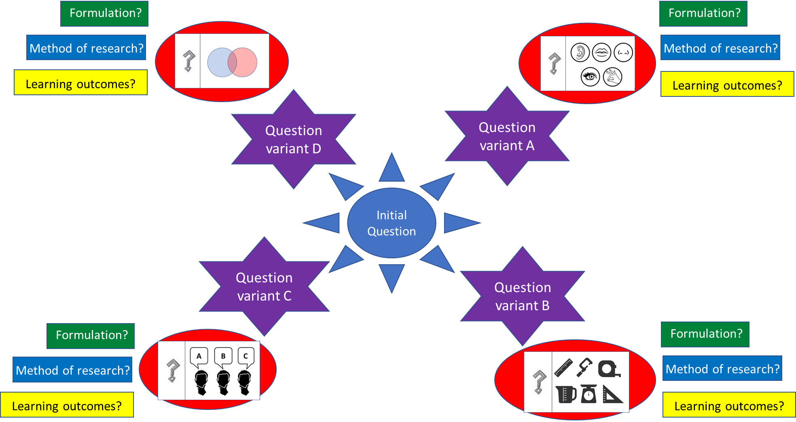
Hypothetical Question-related Learning Trajectories visualized
The Question Compass

Slide 22
Various question types possible
Etc.

Slide 23
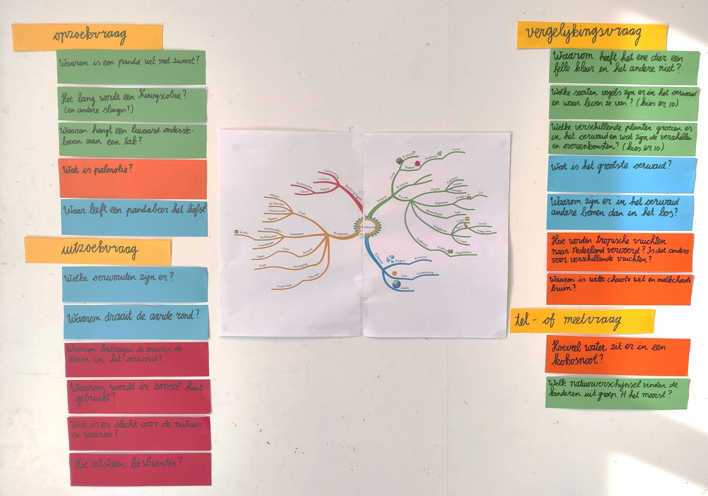
Example Dutch Primary school
Notes:
Kan deze dia hier? Ik dacht leuk om te laten zien dat dit dus al kan vanaf groep 4/5 en hoe je het ordenen van de vragen inzichtelijk kan maken voor de leerlingen.

Slide 24
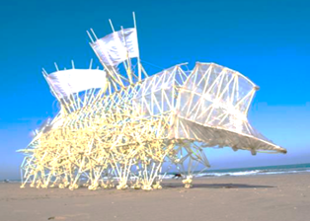
Worked Example: “beach animals”
How does a beach animal move?
What sounds do they make?
What materials are used?
What are the differences between the beach animals?
Which beach animal do you like the most? Why?
How quick can a beach animal move?
Notes:
Vraag toegevoegd ‘what materials are used?’ Deze die wil ik wel doen en de werkvorm inleiden. Heb dia hiervoor gezet die misschien leuk is om nog even te laten zien. Of ergens anders, de koppeling met de praktijk.

Slide 26
Step 1: make up questions (individually)
Observation questions
Comparison questions
Opinion questions
Measurement questions
Write questions on post-its
At least 1 question for each question type
Keep them to yourself for now

Slide 27
Stap 2: exchange questions
Paste the questions one by one under each question type
Discuss: What do you find striking?

Slide 28
Stap 3: write follow-up questions
Follow-up question
Follow-up question
Follow-up question
Follow-up question
Choose a question from someone else
Make up a follow-up question
Do this for each question type

Slide 29
Stap 4: discuss and compare
View the follow-up questions to your questions
Discuss with each other: What stands out?

Slide 30
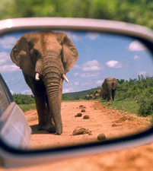
Reflection
What did you notice during this exercise?
What could this bring to teachers?
Questions?

Slide 31
findings of design-based research?

Slide 32
Research question
To what extent do primary school teachers experience their application of hypothetical question-related learning as effective for guiding learning questions?
Notes:
Plaatje toepassen
Plaatje effectief/waarderen

Slide 33
Research Method
participatory design-based research

Slide 34
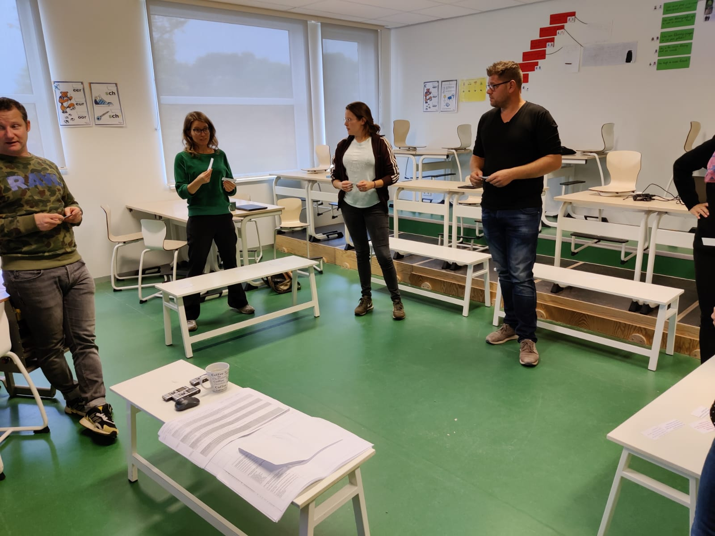
population
4 design teams
30 primay school teachers
4 to 12 year old students
6 primary schools
Experienced in working with scenario
Notes:
Foto nog gevonden, mag ook weg als je het minder vindt

Slide 35
procedure
Design
Brainstorming:
Implementation
Experiment in own class:
follow steps of scenario
use Question Compass where planned
Evaluation
Reflect on:
feasiblility of guidance
development question literacy
elaborating goals and plan for own classroom context
exploring the possibilities of the question compass
choices made

Slide 36
Results: generate questions
Emphasis on diverse types of research support students in diversifying their questions
Sample questions from students encourage their peers to come up with new questions of the same type

Slide 37
Results: formulate questions
Use of the question compass improves question quality (wording and diversity)
Classifying and discussing types questions supports reformulation and specification
Discussing feasibility of types of questions is effective as preparation for answering
Need to develop common language about type of questions

Slide 38
Results: answering questions
Necessary to offer scaffolds for research methods (modeling, materials, resources)
Alignment of the learning environment to types of questions/research is very supportive
Success criteria help students to understand what is expected of them
Free choice of questions reveals students’ preference for basic fact-seeking googleable questions

Slide 39
Results: evaluating questions
The Question Compass supports classroom reflection on the relation between question-type <-> research method <-> learning outcomes
The Question Compass supports generation of follow-up questions from new question perspectives

Slide 40
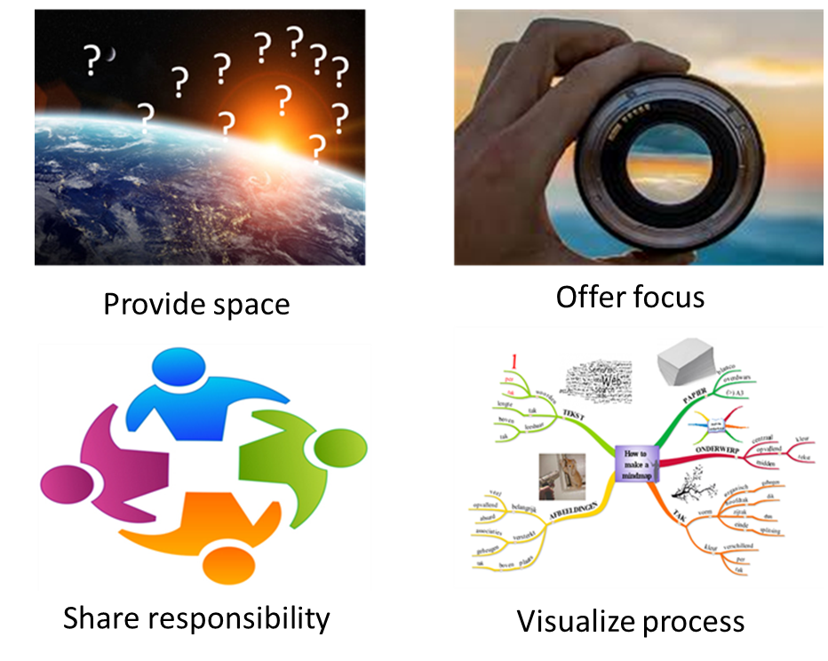
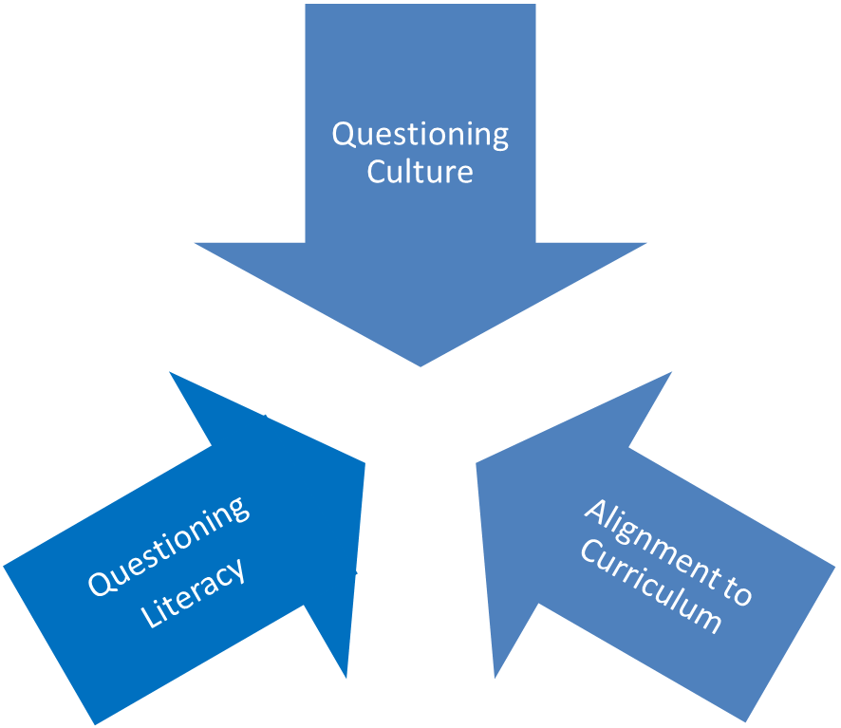
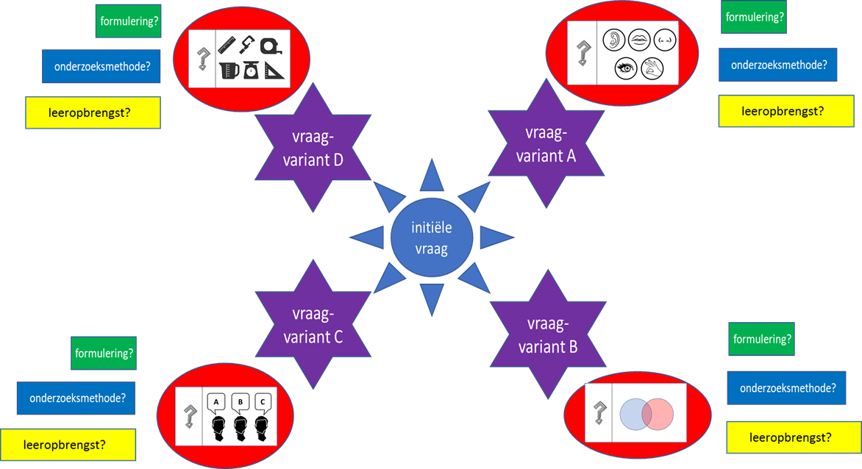
Three types of support for Question-driven learning

Slide 41
Like to know more?
https://bit.ly/Questiondrivenlearning
https://www.researchgate.net/profile/Harry-Stokhof/publications
Harry.stokhof@han.nl

Slide 42
Notes:
afbeelding verkregen op 1-1-2018 van
http://nicojouwe.nl/2017/02/06/10_tips_afsluiters/

Slide 43
Questioning Culture
Questioning
Literacy
Alignment to Curriculum

Slide 44
Questioning Culture
Questioning
Literacy
Alignment to Curriculum

Slide 45
Questioning Culture
Questioning
Literacy
Alignment to Curriculum

Slide 46
Questioning Culture
Questioning
Literacy
Alignment to Curriculum

Slide 47
onderzoeksvragen
Op welke wijze passen basisschoolleraren hypothetische leervraagtrajecten toe in het begeleiden van leervragen?
In welke mate ervaren basisschoolleraren hun toepassing van hypothetische leervraagtrajecten als effectief voor het begeleiden van leervragen
Notes:
Plaatje toepassen
Plaatje effectief/waarderen

Slide 48
Inzichten – vragen oproepen
Eerst voorkennis uitdiepen voor het oproepen van vragen
Vragenbrainstorm is effectief voor oproepen vragen
Mindmap is krachtige scaffold voor brainstorm
Vragenkompas stimuleert diversiteit aan vragen
Voorbeeldvragen van leerlingen stimuleren andere LL
Specifieke prikkels versterken het oproepen van vragen

Slide 49
Inzichten – vragen waarderen
Gebruik van het vragenkompas verbetert vraagkwaliteit (formulering en diversiteit)
Samen vragen waarderen vergroot inzicht in type vragen
Onderzoekbaarheid bespreken is effectief als voorbereiding op beantwoorden
Gemeenschappelijke taal nodig over type vragen

Slide 50
Inzichten – vragen beantwoorden
Vrije keuze versterkt voorkeur voor bekend type vraag (opzoekvraag)-BB
Scaffolds voor onderzoeksmethoden bieden (materialen, bronnen, voorbeelden) (OB-MB-BB)
Succescriteria vooraf geven (BB)
Leeromgeving inrichten op onderzoeksmethode (MB)

Slide 51
Inzichten – vragen evalueren
Mindmap ondersteunt diepgang van de kennisuitwisseling
Vragenkompas biedt ondersteuning voor vervolgvragen (BB)
LL kunnen gericht (samen) reflecteren op antwoordproces

Slide 52
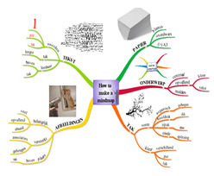
Samenvattend

Slide 53
Summarizing: three types of support
Question culture
Alignment to curriculum
Questioning skills

Slide 54
Step 1: make up questions (individually)
Write questions on post-its
At least 1 question for each question type
Keep them to yourself for now

