Slide 1
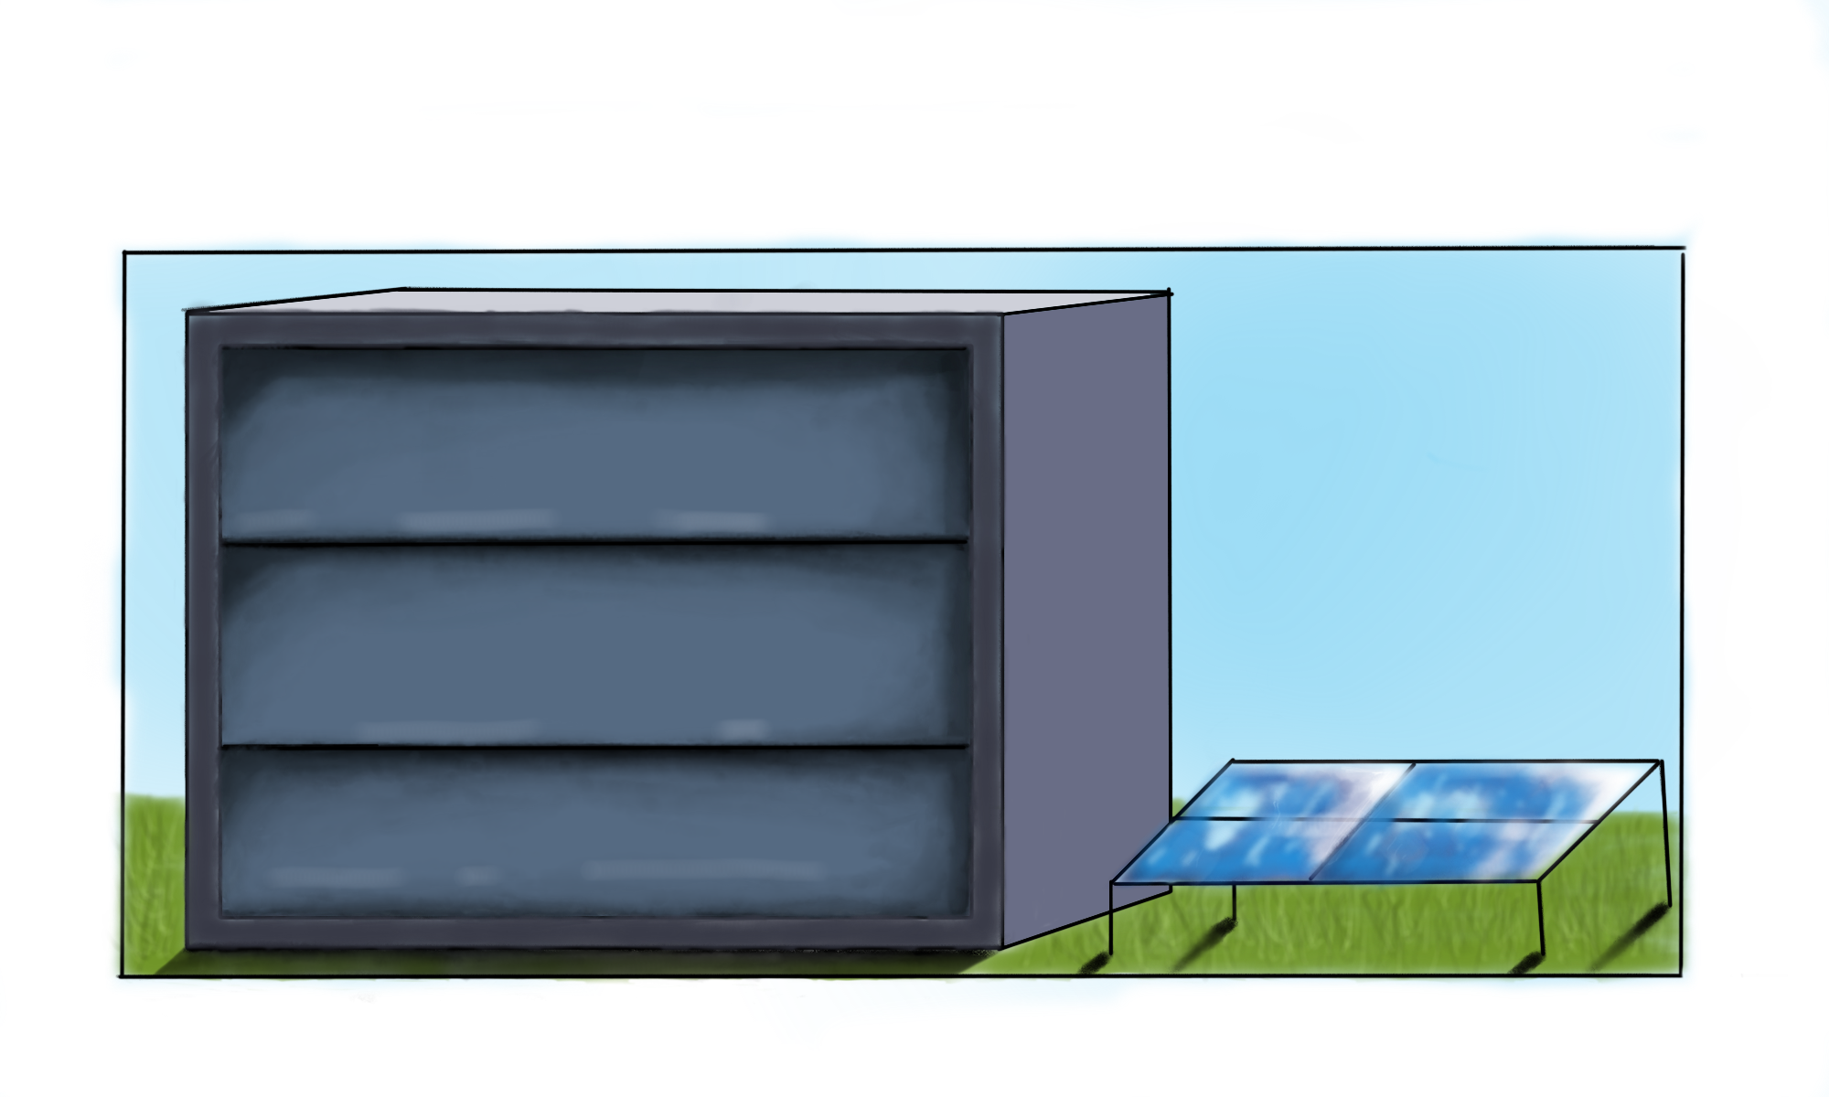
Revalorising Hatches
Ariana Walters
Inês Guimarães
Alex Harper
Ruben de Jong
Ilkay Sayan
Erickson Helder
Abdulhadi Alwattar
Coolheat is the project commissioned by HAN, carried out by 7 second-year students from several HAN universities of sciences, bachelor's degrees. Two separate reports are done by the students from two different courses: Mechanical Engineering and Electrical Engineering.
The use of excess energy is a rising concerning issue in the world today. The operation of costly modern ventilation systems, require a lot of energy without being efficient as possible. This causes high energy usage that results in higher costs, with an addition to global warming.
Maintaining the internal temperature of a home is the main mission of the project.
The problem the group aims to solve this by creating a system that will regulate internal temperature while reducing energy usage by being more efficient and sustainable.

