Slide 1
Welcome

Slide 2
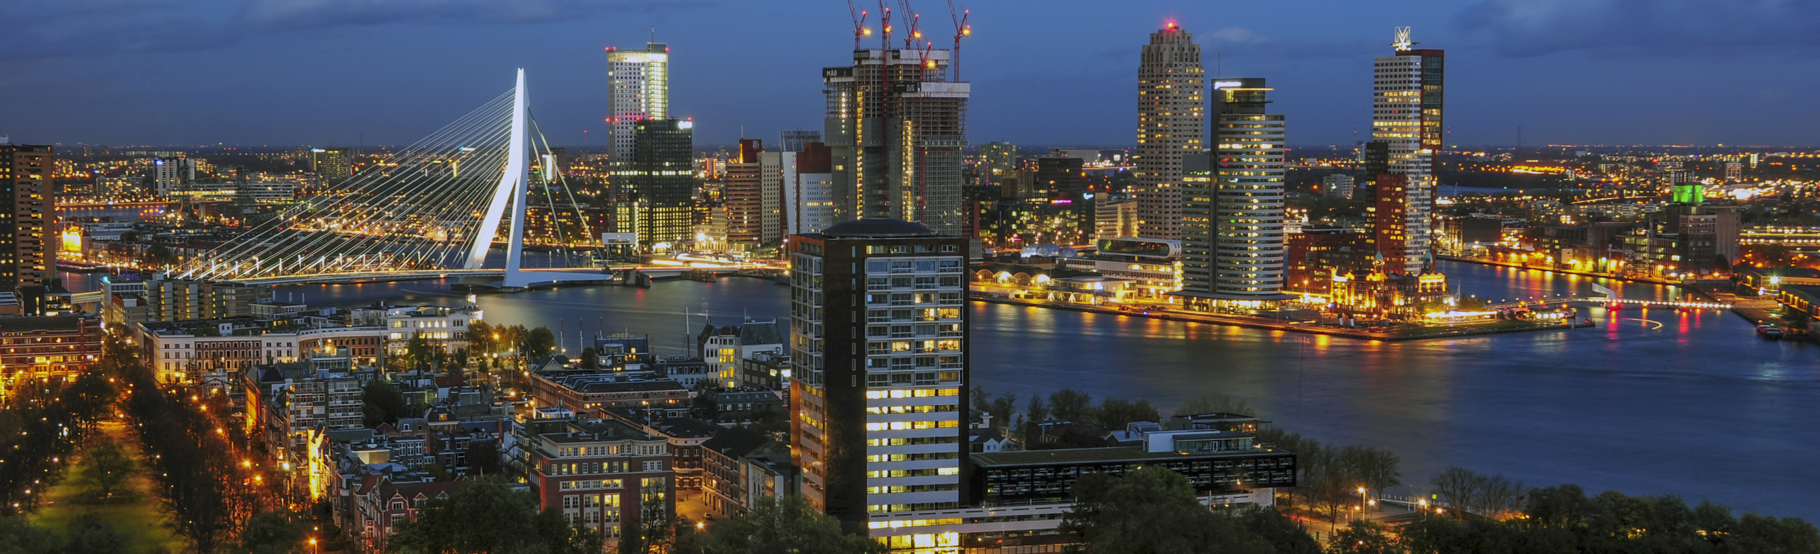
7 locations in the western part of The Netherlands
>25.000 students
We are working in Rotterdam for the faculty of Business, Finance & Law

Slide 3
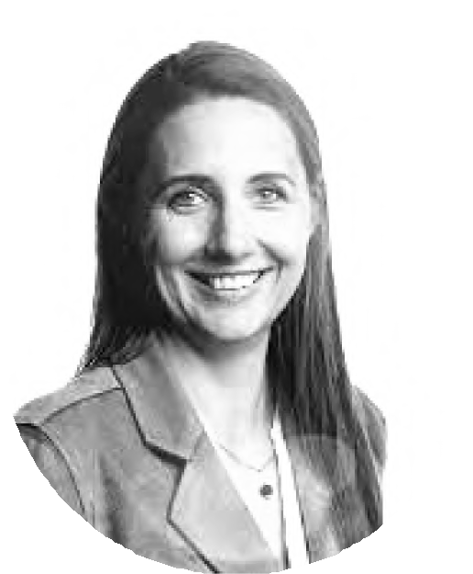
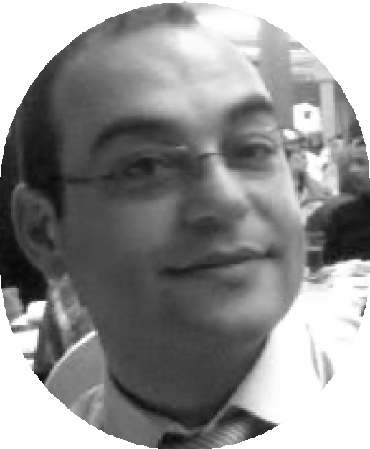
Who we are
Enthusiastic multi-disciplinary professionals from Inholland University of Applied Sciences
Linda Snippe
Prof. Sustainable Risk Management
AbduL Kara
Prof. Creative Business & Economics

Slide 4
Our programme for today
Introduction
01
Sustainable Risk Management Fundamentals
02
Applying Sustainable Risk Management for Positive Outcomes
03
Co-creating New Tools for Sustainable Risk Management Frameworks
Sharing “Aha” Moments and Reflections
04
05

Slide 5
Sustainable performance &
Risk Management

Slide 6
Strategic risk leadership: The “problem”
It was revealed that research on sustainable development seems to have underestimated the role of responsible leadership in embedding a risk culture that underpins sustainable innovation.
Responsible leaders can establish and maintain a risk culture that promotes sustainable innovation (Chukwudum & Fragouli, 2019)
Traditional performance and risk management is not a guarantee that an organization will survive, through the remaining residual risks, including the “megatrends” in a VUCA world.
Notes:
*Megatrends are strong social, demographic, environmental and technological forces that are profoundly changing our world, for example climate change

Slide 7
Gap in existing literature
Little is known about collective (inter-personal) behavioral dynamics, as well as the determinants and the limitations relevant for effective risk resilience. In this regard, it is desirable that studies on risk and risk management go beyond the traditional management, finance and/or accounting perspectives to include the behavioral perspective as well (Florio, 2022).
Miller et al. (2018) mention strategic leadership, contextual awareness and organizational development as examples of VUCA driven management innovation clusters to focus research on.

Slide 8
The purpose of this study
Analyzing the relationship between sustainable performance and risk management, whereby sustainability, interdisciplinairity and leadership give new insights to the traditional perspectives on performance and risk management in the field of accounting and finance.

Slide 9
Research question
“How to use risk management in an ever-changing environment?”
Notes:
It has been studied by literature review and empirical research, using 51 unique cases.

Slide 10
Conceptual model

Slide 11
Conclusions literature research
Risk management in an ever-changing environment consists of:
Risk leadership (clear sighted, proactive, inclusive, and respond decisively),
For agile organizations with clear and transparent organizational goals, and a
Dynamic model of the world, whereby visions and strategies are always in flux to adapt to this changing world.
In a resilient organization, risks are handled due to a holistic view, where the organization is part of a system consisting all disciplines. With strategic planning, in interaction with chain partners and the area where the organization is involved, future scenario’s arise. It’s about creating awareness and adaptiveness to create an sustainable organization.

Slide 12
Conclusions empirical study
In the results of part 1 of the empirical research, it has been founded that sustainability is not congruent in mission and vision with the strategy and core values and related to sustainability strategies and pursuing SDGs. That means that: organizations do have the ambition to be sustainable, but do not yet have sufficient concrete direction on it, and; organizations have no intention of being sustainable and at the same time in many cases steers towards sustainable policy.
In the results of part 2 of the empirical research, it has been founded that in all sustainability strategies there are organizations (11-28%) that do not have any sustainability criteria in the mission/vision, strategic goals, and core values. On the other side, from the organizations that do not follow a sustainability strategy, 44% of them shows sustainability criteria in mission/vision, strategic goals and/or core values. Same as in part 1, part 2 shows incongruence in mission/vision with managing the organisation for sustainability strategies.

Slide 13
Who we are
vuca
strategy
We’re a team of researchers, strategists, business professionals and all- round problem solvers who have made it our life’s work to build simple, useful and expertly-crafted systems and experiences. Usually they’re digital, but not always.
We partner with forward-thinking businesses who understand the importance of ethical human and sustainable risk and performance management to contribute to a sustainable future .
performance
sustainabilty
business
risk
management

Slide 14
We thought we'd share a simplified version of our research findings, rough ideas, and interactive workshops for the Pitch community.
Feel free to adapt, steal or better 😁

Slide 15
A quote to summarise...
"VUCA - Volatility, Uncertainty, Complexity, Ambiguity - is not a passing trend; it is the new normal."
Bob Johansen

Slide 16
Making
02
connections & bridging gaps

Slide 17
Sustainable risk management
VUCA
Sustainable risk management is a vital aspect of modern organizations. The traditional role of risk management is to protect organizations from negative deviations in a downside tail, but sustainable risk management takes this a step further. It involves managing risk while also creating positive outcomes for the environment, society, and the economy.
Ideate

Slide 18
WORKSHOP

Slide 19
What we are doing today
learn, experiment, deliver
Learn
We will learn how to apply sustainable risk management principles to make decisions beneficial to their organizations, evaluate the purpose, function, and process of risk management
Create
co-create ideas for new tools that can enhance risk management
frameworks

Slide 20
Four awesome outcomes
learning outcomes
This is sub one
You will gain a deeper understanding of the concept of sustainable risk management and its role in creating positive outcomes for the environment, society, and the economy.
This is sub three
You will co-create ideas for new tools that can enhance sustainable risk management frameworks and create value for organizations.
This is sub two
You will examine the building blocks inherent in sustainable risk management frameworks and determine the approach needed to meet organization's needs.
This is sub four
Finally, you will share their learning through “aha” moment worksheets and discussions, and leave with an action plan for applying the learning to your possible work.

Slide 21
VUCA
BRACE OR EMBRACE
01
02
UNCERTAINTY
Living that pain
03
COMPLEXITY
Connecting the dots
04
AMBIGUITY
This is us today!
VOLATILITY
Searching for security
Interconnectedness and
interdependence of systems, processes,
and stakeholders in the business environment
nonlinear and unpredictable outcomes
lack of clarity or understanding in the
business environment
difficult to have informed decisions or take decisive actions.
lack of predictability or clarity
difficult or impossible to estimate the likelihood or impact of events
hard for organizations to plan, prioritize,
and allocate resources.
Unpredictability in business
Instability
Building resilience
Agile
Cultivating a culture of innovation, experimentation, and continuous
learning.
.
requires organizations to develop a
sensemaking approach
requires building a culture of curiosity, empathy, and openness
can lead to hesitation, indecisiveness, and
reluctance to take risks, which can slow down innovation and progress.
requires developing a culture of
innovation, experimentation, and continuous learning

Slide 22
Volatility is one of the four dimensions of VUCA, which stands for Volatility, Uncertainty, Complexity, and Ambiguity. Volatility refers to the degree of instability or unpredictability in the business environment. In a volatile environment, changes can happen rapidly, unexpectedly, and dramatically, causing fluctuations in markets, supply chains, technologies, and consumer behaviors.
For instance, the COVID-19 pandemic has created a highly volatile environment for many organizations, as they have had to deal with sudden lockdowns, disrupted supply chains, shifts in consumer demands, and new health and safety regulations. Volatility can create both risks and opportunities for businesses, as it can disrupt established markets and open up new ones, or accelerate innovation and change.
Managing volatility requires organizations to be agile, responsive, and adaptive, with the ability to sense, analyze, and respond to changes quickly and effectively. This requires building resilience, flexibility, and contingency plans into the organizational strategies, as well as cultivating a culture of innovation, experimentation, and continuous learning.

Slide 23
Uncertainty is another dimension of VUCA, which refers to the lack of predictability or clarity in the business environment. In an uncertain environment, it is difficult or impossible to estimate the likelihood or impact of events, trends, or changes, making it hard for organizations to plan, prioritize, and allocate resources.
For example, the impact of emerging technologies, geopolitical changes, and global economic shifts can create uncertainty about the future, making it challenging for organizations to make long-term decisions or investments. In addition, uncertainty can lead to hesitation, indecisiveness, and reluctance to take risks, which can slow down innovation and progress.
Managing uncertainty requires organizations to embrace ambiguity and complexity, and to be comfortable with exploring multiple scenarios and options. This requires developing a strategic foresight, with the ability to anticipate and adapt to changes, and to create contingency plans and risk management strategies. Moreover, it requires fostering a culture of experimentation, learning, and continuous improvement, with the willingness to embrace failure and uncertainty as a natural part of the innovation process.

Slide 24
Complexity is another dimension of VUCA, which refers to the interconnectedness and interdependence of systems, processes, and stakeholders in the business environment. In a complex environment, there are multiple factors and variables that interact with each other, creating nonlinear and unpredictable outcomes.
For example, the rise of digital transformation and the increasing globalization of markets have made business ecosystems more complex, as organizations need to navigate diverse cultural, regulatory, and technological landscapes, and manage complex supply chains and partnerships. Complexity can also arise from internal factors, such as organizational structures, processes, and systems, which can create silos, bottlenecks, and inefficiencies.
Managing complexity requires organizations to develop a systems thinking approach, with the ability to analyze and understand the interdependencies and relationships between different elements in the ecosystem. This requires building cross-functional teams and networks, fostering collaboration and communication, and developing agile and adaptable organizational structures and processes.
Moreover, it requires developing a culture of innovation, experimentation, and continuous learning, with the willingness to challenge assumptions and explore new ways of thinking and working.

Slide 25
Ambiguity is the fourth dimension of VUCA, which refers to the lack of clarity or understanding in the business environment. In an ambiguous environment, information may be incomplete, contradictory, or difficult to interpret, making it challenging for organizations to make informed decisions or take decisive actions.
For instance, ambiguity can arise from changes in consumer preferences, shifts in market dynamics, or emerging trends or technologies, which can be difficult to interpret or anticipate. Ambiguity can also arise from differences in perspectives, values, and goals among stakeholders, which can lead to conflicts or misunderstandings.
Managing ambiguity requires organizations to develop a sensemaking approach, with the ability to gather and analyze diverse perspectives and data sources, and to identify and challenge assumptions and biases. This requires building a culture of curiosity, empathy, and openness, with the willingness to ask questions, listen actively, and seek feedback. Additionally, it requires developing agility and flexibility in decision-making, with the ability to adapt to changing circumstances and to experiment with new approaches. Finally, it requires building trust and collaboration among stakeholders, with the willingness to engage in dialogue and co-creation, and to seek common ground and shared values.

Slide 26
02
Introduction to sustainable risk management
Purpose, function, and process of sustainable risk management
Building blocks inherent in sustainable risk management frameworks
Understanding and assessing risk in a sustainable context
Identifying opportunities for sustainable outcomes through risk management

Slide 27
03
The role of sustainable risk management in creating positive outcomes for the environment, society, and the economy
Case studies and examples of sustainable risk management frameworks
Turning risk into opportunities for sustainable outcomes
How to use sustainable risk management to support strategic decision- making

Slide 28
03
Time for a short break… .

Slide 29
Making
04
connections & bridging gaps

Slide 30
Workshop activity
Co-creating New TooLs for SustainabLe Risk Management Frameworks (40 minutes)
Let's generate ideas to take a first step towards our big goals, and solve this problem/opportunity that we have on hand.
Get your first group ideas out fast. It might feel uncomfortable to get going, that's the point!
It's okay to write words, or you can draw your ideas if you prefer. This is not a competition.
We're looking for impactful thinking 💭
Workshops are cooL 😎

Slide 31
Workshop activity
Idea 1
Idea 2
5:00
Idea 3
Idea 4
You have 5 minutes to sketch as many ideas as possible.

Slide 32
Activity
Each participant can duplicate this slide, for example, and spend 5 minutes jotting ideas in their assigned slide.
One idea per sticky
One idea per sticky
One idea per sticky
One idea per sticky
One idea per sticky
One idea per sticky
One idea per sticky
One idea per sticky
One idea per sticky
One idea per sticky

Slide 33
Workshop activity
You have 5 minutes to finalize your co- creation

Slide 34
Finalize and summarize
Bringing into modeL
Let's finalize the ideas
Each group shares their “aha” moment worksheet and reflections on what they learned and how it can be applied.
We're looking for impactful results
New ideas are cooL 😎

Slide 35
Voting results
Dot-voting participants vote on their chosen options using a limited number of votes.
Idea A
Idea C
42% · 16 Votes
42% · 16 Votes
Idea B
Idea D
42% · 16 Votes
42% · 16 Votes

Slide 36
Presentations of groups
Short sharings & Reflection

Slide 37
AND THE WINNER
IS…….
Winning is cooL

Slide 38
Thank you

Slide 39
Stay in touch
Linda Snippe
Prof. Sustainable Risk Management
www.linkedin.com/linda-snippe
AbduL Kara
Prof. Creative Business & Economics
www.linkedin.com/abdul-kara

