Slide 1
“A risk resilience approach: multiple value creation and competitive advantage for (agricultural) enterprises”
Linda Snippe MSc. CBM
September 28, 2023.

Slide 2
Index
01
Purpose of this study
.
02
Research approach
.
03
Result: the Risk Resilience Approach
.
04
Scientific contribution and further research
.

Slide 3
1. Purpose of this study
To find determinants about risk resilience and
Develop a new risk resilience approach for (agricultural) enterprises.
This approach creates the ability to respond resiliently to major environmental challenges and changes in the short term and adjust the management of the organization, and to learn and transform to adapt to the new environment in the long term while creating multiple value creation.
Why is this relevant?

Slide 4
“It is not the strongest of the species that survives, nor the most intelligent. It is the one that is most adaptable to change” – Charles Darwin.
The new Risk Resilience Approach needs to provide a holistic view that enables entrepreneurs, boards, and stakeholders to operationalize their ambitions from a responsible and sustainable business, including environmental, social, governance elements in interaction with the system they are part of.

Slide 5
2. Research approach
This project started with:
searching for gaps in the literature regarding risk management models and
practical research whether risk management needs an innovative perspective to remain useful and effective.
Research methods:
Literature study
→ Narrative about sustainability: transforming to multiple value creation
Determinants about: risk resilience, competitive advantage, agricultural resilience
Focus groups
Design of a Risk Resilience Approach

Slide 6
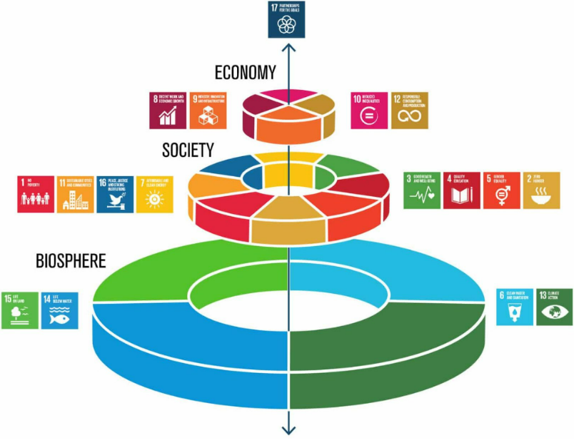
Narrative about sustainability
Notes:
approximately 35 years ago the first small steps were made to introduce sustainability.

Slide 7
Risk resilience
“Risk resilience refers to the ability of an individual, organization, or system to withstand, adapt to, and recover from risks and disruptions. It involves the capacity to identify potential risks, assess their potential impact, and implement strategies to mitigate and manage those risks effectively.”

Slide 8
Competitive advantage
“The ability to innovate, adapt and respond in an effective way to changing business environment aiming a sustainable and dynamic edge over competitors”

Slide 9
Agricultural resilience
“Agricultural resilience refers to the ability of agricultural systems, such as farms and food production networks, to withstand and recover from various shocks and stresses while continuing to provide essential food and agricultural products. It involves the capacity of these systems to absorb, adapt, and transform in the face of challenges such as climate change, extreme weather events, market fluctuations, and resource constraints.”

Slide 10
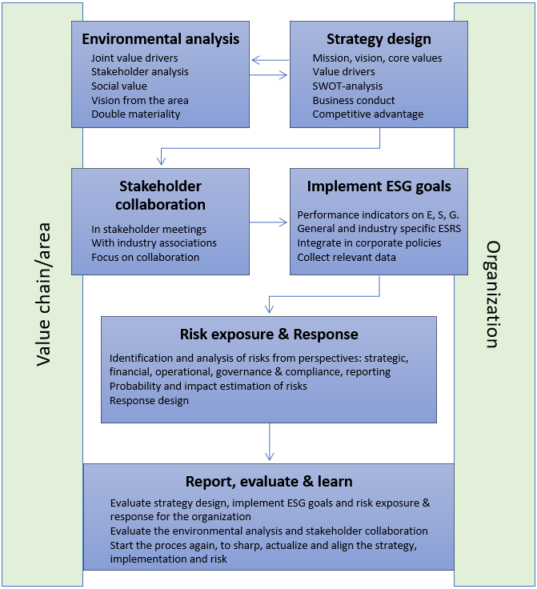
3. Result: Risk Resilience Approach
In each step the organizational perspective, as well as the value chain/area perspective is considered and aligned.
Risk management is part of the planning and control cycle.

Slide 11
4. Scientific contribution
Scientific contribution:
Revisits the conceptualization of risk resilience. It integrates multiple disciplines, like risk management, strategic management and has a focus on the external environment.
It looks to the concept of competitive advantage in a systematic way, from the perspective of multiple value creation and double materiality.
It looks from an pragmatic and entrepreneurs perspective to agricultural resilience.
Proposes a revised conceptual approach for risk resilience in general, with an additional part for agricultural organizations. It combines antecedents based on prior knowledge and moderators for risk resilience in a multidimensional (ESG) context.

Slide 12
4. Further research → apply this approach
Develop a “risk resilience approach”
Spring 2023
Train students to work with this approach
September 2023
Apply this approach at agricultural enterprises
October-December 2023
Evaluate the value with entrepreneurs to validate the approach
Spring 2024

Slide 13
Ideas for further research directions
Expand and refine this approach for other sectors to make it more widely applicable; this means that determinants of the “other sector” need to be studied.
Apply the risk resilience approach for enterprises in field work studies (with students?)
How to integrate risk management activities in planning and control cycle for SMEs. Entrepreneurs sometimes do risk management activities without being conscious of it, and the other way around.
The learning process from and adapting to (changing) risks for SMEs

Slide 14
Thank You for your attention. Feel free to contact me on linda.snippe@inholland.nl

