Slide 1
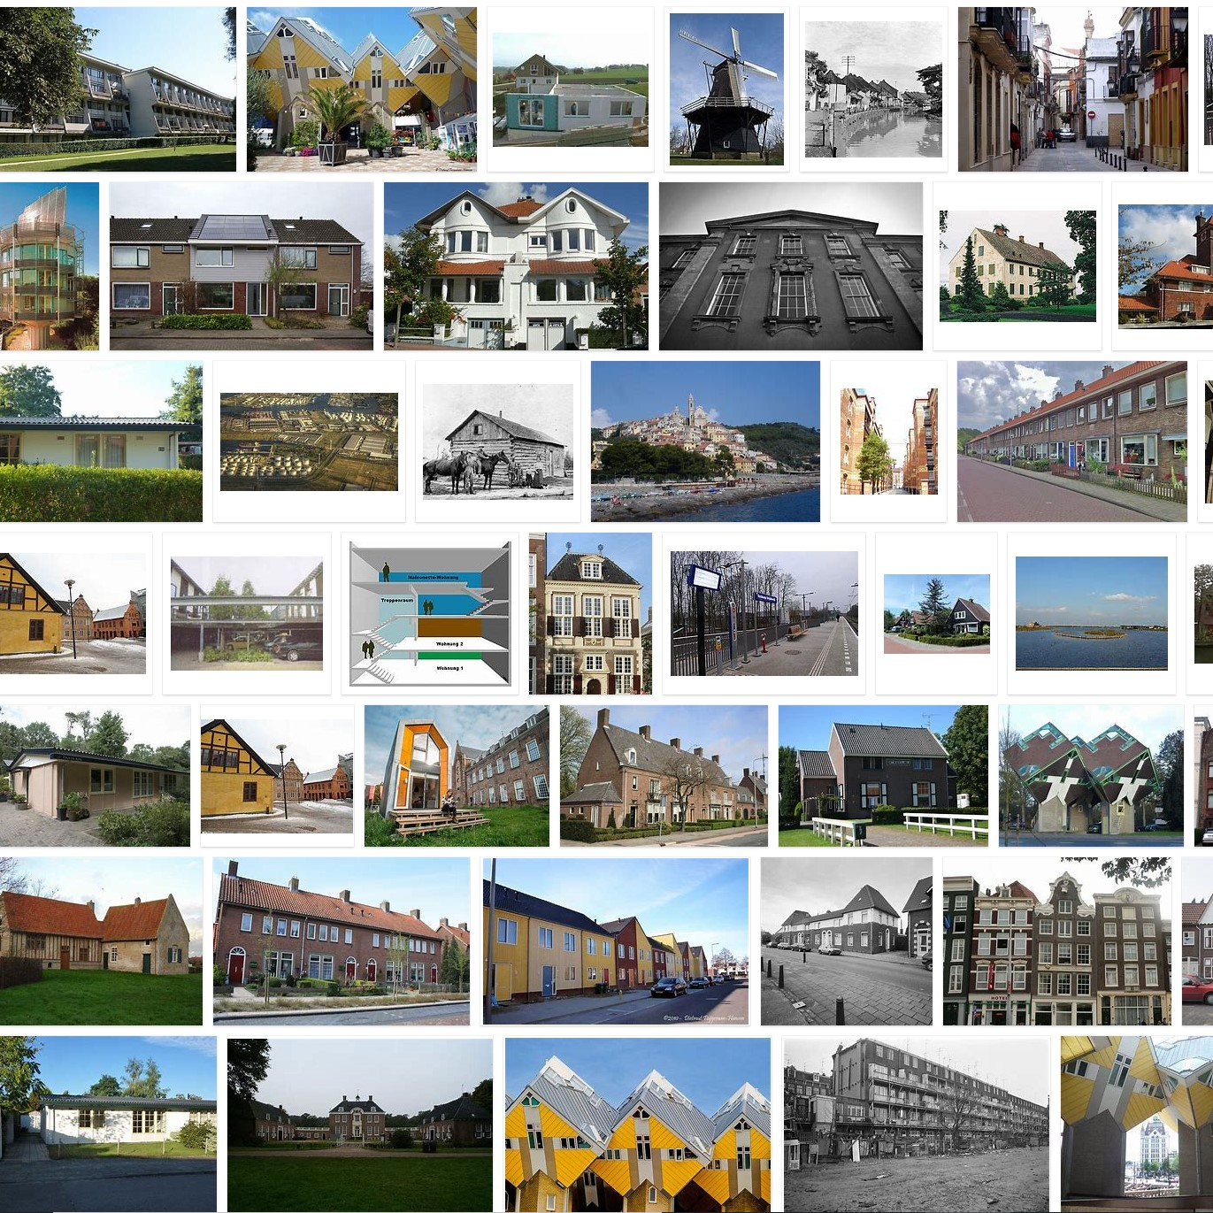
transmissie
infiltratie
ventilatie
verwarming
zon-instraling
‘interne’ warmte
warmteverlies
warmtewinst
Digital Twins for the
heating transition:
Testable hypotheses
Twomes Deliverable D4

Slide 2
Digital Twins for the heating transition:
Testable hypotheses
Twomes Deliverable D4
Author: Henri ter Hofte
Publication date: 27-01-2022
Parties involved: Research group Energy Transition (Windesheim)
Chair: Jeike Wallinga
This work is financially supported by BDR Thermea, Breman, Enpuls, TechForFuture, Witteveen + Bos and the municipality of Zwolle.
This is a publication by Saxion, University of Twente and Windesheim University of Applied Sciences
Licence: CC BY 4.0, Research group Energy Transition, Windesheim University of Applied Sciences
Notes:
The results of project Twomes are described in the following deliverables:
Deliverable D1a Project Plan
contains the project plan that forms the basis for research activities.
Deliverable D1b Data management plan
describes what data is collected in the project, how data should be handled during the project and after the project is finished.
Deliverable D1c: Uitkomsten bewonersonderzoek
describes (in Dutch) the results of the research we conducted into questions residents have about the heat transition, via surveys and/or interviews. We used insights gained to focus further research in the project lays the foundation for advice modules.
Deliverable D2: Dataset 1
contains the monitoring data that we collected for exploratory analysis.
Deliverable D3: Analysis Methods and Tools, Version 1
contains a description of the analysis methods and tools used to analyze data from Deliverable D2. We also describe what we can learn from the available data and what additional measurements we deem necessary.
Deliverable D4: Testable Hypotheses
describes the hypotheses we want to test with the research in Twomes.
Deliverable D5: Measurement methods and techniques
describes the (additional) measurement methods and techniques that we have developed to collect data used to test hypotheses from D4.
Deliverable D6: Subject Information, Consent Forms
includes all information and documents (in Dutch) we use to recruit and educate subjects, including a description of how we obtain consent to collect data.
Deliverable D7: Dataset 2
contains the data that we collected to do a detailed analysis including research into the hypotheses of D4.
Deliverable D8: Analysis Methods and Tools
describes not only the analysis methods and tools we applied to the dataset from D7, but also the results and conclusions of this analysis.
Deliverable D9: Dissemination and design follow-up research
includes all external presentations and publications for interested parties outside the project, including a plan for a follow-up study for the realization of advice modules.
Deliverable D10: Presentations, Report, Update Plan and Schedule
includes all interim and progress presentations of the project, and updated plans.

Slide 3
Research questions / hypotheses
WP3 Data Analysis & Prediction
Can indoor temperature and gas usage time series be predicted well enough based on
model parameters learned from past observed data using inverse grey-box modeling?
  Past observed data?
    T_{set} [°C], T_{in} [°C], T_{out} [°C], W [m/s], I [W/m²], T_{sup} [°C], T_{ret} [°C], E_{P1} [kWh], G_{P1} [m³], E_{P3/P4} [kWh], G_{P3/P4} [m³]
    Past 2 weeks
  Model parameters?
    Building: H [W/K]; τ [h]; A [m²]
    Installation : η_{upper;CH} [%], P_{max} [W]
    Comfort: <T_{set;h;d}> [°C]
  Predicted well enough?
    Next week following past weeks, using observed values for T_{set} [°C], T_{out} [°C], W [m/s], I [W/m²] in that next week
    Root Mean Square Error (RMSE) between predicted and observed values as error metric
    Relative to… (1) Error of predictions using model parameters that can be derived from open building data and parameters used in ISSO82.3 / ‘Nader voorschrift’ (used until 2020 in NL to calculate provisional energy label)
    Relative to …(2) Error between predictions and observations that are typically achieved according to literature using building simulation tools such as Passive House Planning Package (PHPP) … if any available?

Slide 4
Research questions / hypotheses
WP3 Data Analysis & Prediction
(How much) Does the accuracy of the prediction change using 1 wk / 3 wks of past data?
Can we leave out certain (hard to get) measurement time series data as input
and (still) predict indoor temperatures and gas usage well enough?
  E_{P1} [kWh], G_{P1} [m³] (P1-port monitoring data)?
  T_{in} [°C] (indoor temperature monitoring data)?
  T_{ret} [°C] (return temperature monitoring data)?
(How much) Does the accuracy of the prediction change if we include
CO₂ concentration [ppm] monitoring data and presence monitoring data [pp_{d;h}]
in order to separate ventilation losses from infiltration losses?
Bonus for subjects that reported an intervention:
Are model parameters learned before and after the intervention significantly different?

